Slide 1
CONGENITAL HEART DISEASE (CHD)
Dr. Gemechu E (MD, Assistant professor of Pediatrics and Child Health)
November 19, 2023 G C.

Slide 2
Outlines
To revise the fetal circulation briefly
To discuss about the classification of congenital heart disease
Discuss the common acyanotic and cyanotic congenital heart diseases epidemiology.
Pathophysiology and clinical presentation
Investigation and principles of management of common CHD

Slide 3
At the end of the lecture a student should be able to discus
Basic fetal circulation
Classification of CHD
The epidemiology
Pathophysiology
Clinical presentation and physical findings of common CHD
The principles of management including relevant investigations for respective lesions .

Slide 4
Fetal Circulation
Fetus received Oxygen and nutrients from the mother through the placenta and umbilical cord.
The fetus also rely on the mother to dispose of waste
In the fetus right and left ventricles exist in a parallel circuit.
Circulation relay on shunt through
  Foramen ovale
  Ductus arteriosus
  Ductus venosus
Thus it can be defined as a ‘shunt-dependent’ circulation

Slide 5
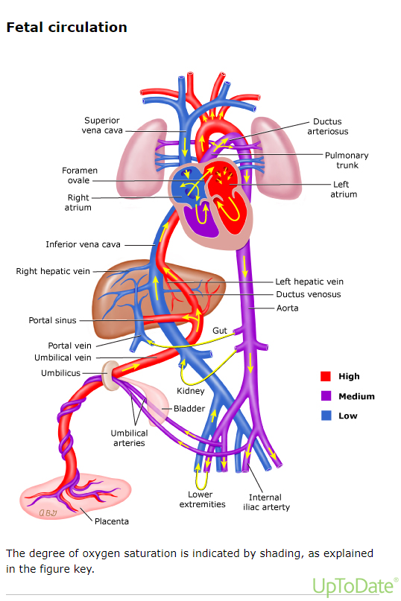
Fetal Circulation
Arterial blood leaves the placenta via the umbilical vein
This branches and delivers blood to the IVC by way of the ductus venosus
Blood then goes into the right atrium, goes across the foramen ovale
Blood from SVC →RV via TV→RV then to PA
Instead of going to the lungs, >85% goes through the PDA to the aorta
Notes:
Pulmonary arterial blood entering through pulmonary veins 91/5th) ivc blood entering through PFO (4/5th) right arm and head 60%
Left arm and lower part of the body are supplied by mixture of LV and PDA less than 60%

Slide 6
Transitional circulation
Interruption of Umbilical cord:-
- Removal of the low resistance placental circulation result in an ↑ SVR
- Lack of blood flow through the placenta leads to closure of Ductus venosus (the ligamentum venosum)
Expansion of lungs :
- Mechanical expansion of the lungs and increased arterial PO2 result in a rapid decrease in pulmonary vascular resistance.
- The increased blood volume from the pulmonary circulation increased the LA volume and pressure sufficiently to close the foramen ovale (fossa ovalis)
PDA closure : The ductus flow become left to right and later the ductus will obliterated (ligamentum arteriosus)
Notes:
.

Slide 7
Transitional circulation
The right ventricle is coupled with low resistance pulmonary circulation and its wall thickness and mass decreased
The left ventricle coupled to high resistance systemic circulation and its wall thickness and mass ↑ and deliver the entire systemic CO.
There is a change from fetal haemoglobin to adult haemoglobin

Slide 8
Congenital Heart disease
Introduction
Structural or functional heart and major vessels disease that present at birth.
It is not static ,there is always a continuous anatomical or physiological change
At least 18 distinct types of CHDs are recognized, with many additional anatomic variations.
The incidence is higher in abortus and still births
Prevalence at birth ranges from 6 to 13 per 1000 live births

Slide 9
Introduction
CHD is the most common congenital disorder in newborns.
The etiology - > multi factorial (genetic &environmental)
In less than 10% of cases the cause-effect established.
Two to 4% associated with known environmental or adverse maternal conditions and teratogenic influences
8% genetic
Critical CHD accounts for approximately 25 % of all CHD.
Mortality of CHD is greater during early infancy.

Slide 10
Introduction…
Risk factors
Environmental factor
Increased prevalence of PDA & ASD in children born at high altitude.
High incidence of CHD in children of mothers who are diabetic or alcoholic.
Congenital infection: Rubella associated with increased number of PDA and pulmonary stenosis.

Slide 11
Introduction….
Prematurity: 2-3 fold higher in preterm compared with term infants excluding PDA
Maternal factors: DM, HTN, obesity, smoking, alcohol, systemic connective tissue disorders, phenylketonuria, epilepsy…
Metabolic factors, genetic and chromosomal aberrations are also known to predispose to CHD.
Chromosomal defects were detected in 7 percent of patients with CHD, and extra cardiac anomalies in 22 percent.
Family history – first-degree relatives who have nonsyndromic isolated CHD is estimated to be 3 to 4 fold higher than that of the general population
Congenital heart defects can arise at any stage of development in intra uterine life,
ART:

Slide 12
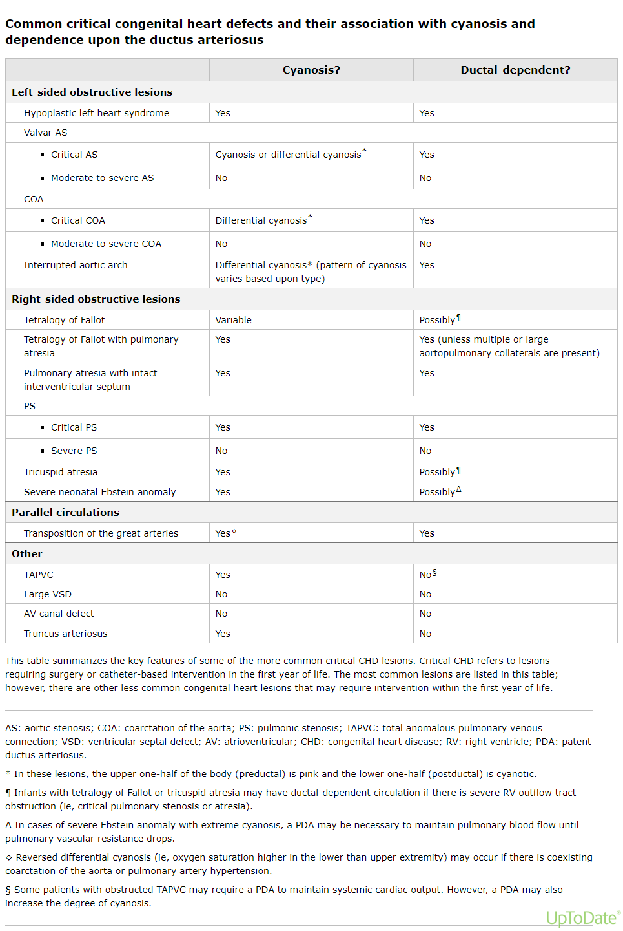

Slide 13
DIAGNOSTIC EVALUATION
A cardiac examination allows
Guide the echocardiographic evaluation toward confirming or eliminating specific diagnosis, thereby increasing its accuracy
Eliminate unnecessary and expensive laboratory tests (innocent murmurs
Reassuring the patient's family and preventing unnecessary restrictions on healthy physical activity

Slide 14
History :
Antenatal history: exposure to any teratogen, phenytoin, thalidomide, lithium, maternal DM & etc.
Family history: risk of having CHD 2-6%
- the risk is 14% if the mother has CHD.
In most of the cases the cause is multi-factorial
Familial occurrence of ASD, PDA, VSD, TOF & AS.

Slide 15
History…
Perinatal period, including the presence of cyanosis, shock, respiratory distress, or prematurity.
Symptoms of CHF in infants and children are age specific
Exercise intolerance, sweating during crying or feeding, frequent interruption of feeding, shortness of breathing, poor growth and syncope.
More severe manifestations- orthopnea & nocturnal dyspnea
Cyanosis during crying or exercise or during breath-holding spells;

Slide 16
Physical examination
Systemic examination includes
  G/A, V/S, and anthropometric measurement.
    Persistent tachycardia (>200 beats/min in neonates, 150 beats/min in infants, or 120 beats/min in older children), bradycardia, requires investigation to exclude pathologic arrhythmias
    A wide pulse pressure with bounding pulses may suggest: PDA, AR, an arterial-venous communication, or increased CO 2⁰ to anemia, anxiety, …
Notes:
CO = SV * HR
BP= CO * SVR

Slide 17
Physical examination…
Diminished pulses:- pericardial tamponade, left ventricular outflow obstruction, or cardiomyopathy.
Radial-femoral delay → CoA
Blood pressure: Difference (arms vs legs) → CoA
JVP-provides information about central venous and right atrial pressure

Slide 18
Physical examination…
Hyperdynamic precordium : large L-to-R shunt, thin people
A silent precordium: with a barely detectable apical impulse suggests pericardial effusion or severe cardiomyopathy
Greater than 30% of children may have an innocent murmur at one time in their lives
Absence of a murmur does not rule out significant CHD

Slide 19
Physical examination
Cyanosis
Cardiac failure and chronic cyanosis result in failure to thrive
Cyanosis is observed: nail beds, lips, tongue, and mucous membranes
Pulse oxiymetry :- Pre- and post ductal pulse oximetry to assess for cyanosis and differential cyanosis.
Hyperoxia test to rule out non cardiac origin of cyanosis.
Pulmonary condition & PPH respond for 100% oxygen & PO₂ >150mmHg.

Slide 20
Summary
CHD suspected in any child with:
Feeding difficulty
Recurrent attack of respiratory tract infection
Growth failure
Positive pulse oxiymetry screening
Cyanosis unresponsive to 100% oxygen
Tachycardia
Respiratory distress
Rhythm disturbance
Murmur ( absence of murmur doesn't rule out or in CHD)

Slide 21
Radiology evaluation
ECG
CXR
Echocardiography
Angiography
Cardiac catheterization
MRI.

Slide 22
Echocardiography indications
Signs or symptoms concerning for critical CHD,
Including shock unresponsive to volume resuscitation,
Cyanosis or differential cyanosis, failed hyperoxia test,
Unexplained respiratory symptoms, or pulmonary
ECG and/or chest radiograph findings suggestive of CHD
P/E findings suggestive of CHD, including abnormal heart sounds (eg, S3 gallop, single S2, click), pathologic murmur, diminished or absent lower extremity pulses, abnormal 4 extremity BP.
Positive pulse oximetry screening
Genetic disorder or extra cardiac malformation associated with cardiovascular malformations

Slide 23
CLASSIFICATIONS
Evaluation of the infant or child with CHD has 3 major components:
  2 major groups cyanotic and acyanotic
  - These 2 groups further sub-divided with CXR evidence of ↑sed, normal or ↓sed pulmonary vascular markings.
For diagnostic purpose can be classified as :
  Left to right shunt
  Right to left shunt
  Obstructive lesions

Slide 24
Acyanotic CHD with left to right shunt
  * Shunting of fully oxygenated blood back in to the lung.
  Ventricular septal defect(VSD) 25-30%
  Atrial septal defect (6-8%)
  Patent ductus arteriosus (6-8%)
  Atrio ventricular septal (AV canal) defect

Slide 25
2. Acyanotic CHD with obstructive lesions
Pulmonary stenosis (7-10%)
Coarctation of aorta (5-7%)
Congenital Aortic stenosis (4-7%)
Aortic arch anomaly
Hypo plastic left heart syndrome.
Ebstien anomaly

Slide 26
3. CYANOTIC CHDs:
Tetralogy of Fallot/TOF (5-7%)
Transposition of great arteries(TGA)
Truncus arteriosus
Tricuspid atresia
Total anomalous pulmonary venous connection.
Notes:
Cyanosis — Cyanosis is an important sign of critical CHD. Cyanosis is the bluish skin tone caused by the presence of ~3 to 5 g/dL of deoxygenated hemoglobin. However, cyanosis may not be readily clinically apparent in patients with mild desaturation (>80 percent saturation) or anemia [51]. Cyanosis can be especially difficult to appreciate in darkly pigmented infants. Pulse oximetry is helpful to detect mild desaturation in patients with cyanotic CHD.

Slide 27
Case 1
Fatuma is 3 month old infant presented at OPD with a c/c of fast breathing and excessive sweating specially when she feeds on breast . She has no fever , she did not gain adequate weight for her age . She was treated for pneumonia 2 times since the last 2 months .
P/E : She is tachypneic, tachycardic, clear chest. she has active precordium, shifted PMI, no audible murmur, 4cm palpable liver BRCM.

Slide 28
1. Acyanotic CHD with left to right shunt
1.1. VSD
The most common form of CHD ( 25% of all CHD).
Male > female
Can be at membranous (commonest type) or muscular type
The size of the VSD is major determinant of the left-right shunt.
QP: QS is1:1 the flow is bidirectional, when it reach QP: QS is 2:1 left atria &ventricle volume over load.

Slide 29
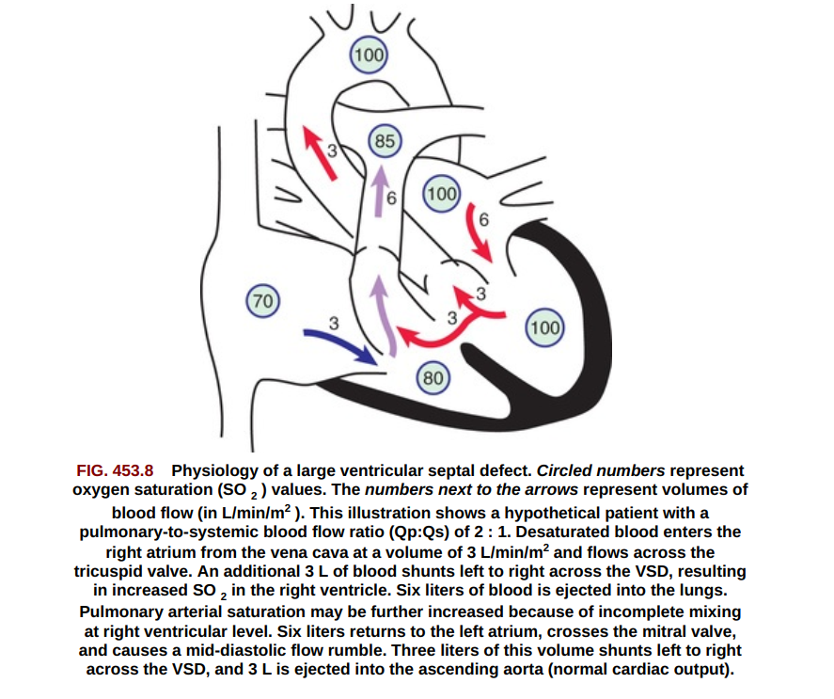
1.1. VSD
Small VSD (Restrictive VSD) -is most common type.
Loud harsh left parasternal holosystolic murmur.
ECG of small VSD is normal or show LV hypertrophy.
CXR: normal or cardiomegaly with increase pulmonary vasculature.
30-50% of small VSD closed spontaneously usually in the 1ST 2yr of life (Small VSD muscular type 80% & membranous type up to 35% close spontaneously.)

Slide 30
VSD cont.…
Types of VSD
70% perimembranouse
5-20% Muscular
5-8% sub pulmonic ( Subarterial)( more in south east Asia
8-10% AV canal septum type ( inlet)

Slide 31
Clinical presentation
Severity depend on :
Size of the defect
Level of pulmonary to systemic resistance.
Majority of Small restrictive lésions closes spontaneously
Large defects lead to CHF at early age

Slide 32
VSD- Large
Lesion close to aortic root size />6mm
Dyspnea, feeding difficulty, poor growth, recurrent LRTI, &cardiac failure in early infancy.
  Parasternal heave, less intense shorter murmur.
  Pulmonary and right ventricular hypertension.
  Mid diastolic rumbling murmur at the apex caused by increased blood flow at the mitral valve’ which indicate the ratio of QP: QS is >2:1.
  CXR: gross cardiomegaly. Prominence of ventricle, left atria, and pulmonary artery, sign of pulmonary edema with effusion.

Slide 33
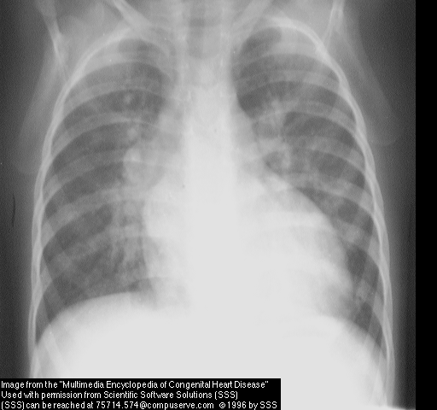
Chest X-Ray (VSD)
Cardiomegaly
(LA, LV,RV,PA)
Increased vascular marking

Slide 34
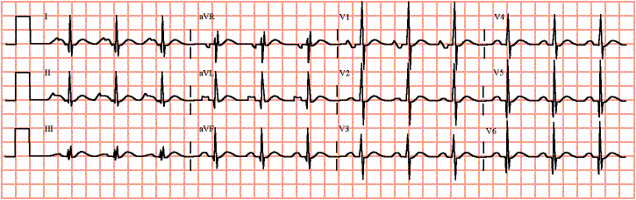
Diagnostics cont…
ECG:
P wave peaked and notched
Left ventricular hypertrophy or biventricular

Slide 35
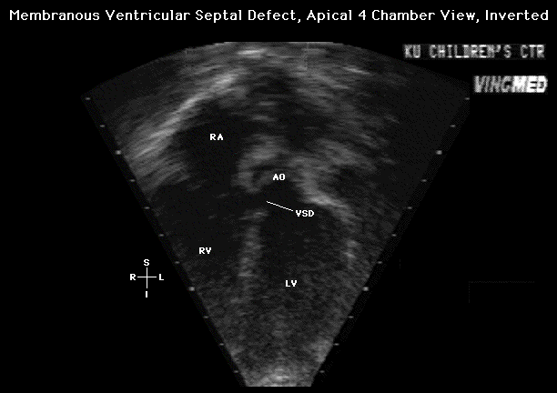
Echocardiography (VSD)
Position and size of VSD
Chambers size
Pressure gradient across the defect
Direction of shunt

Slide 36
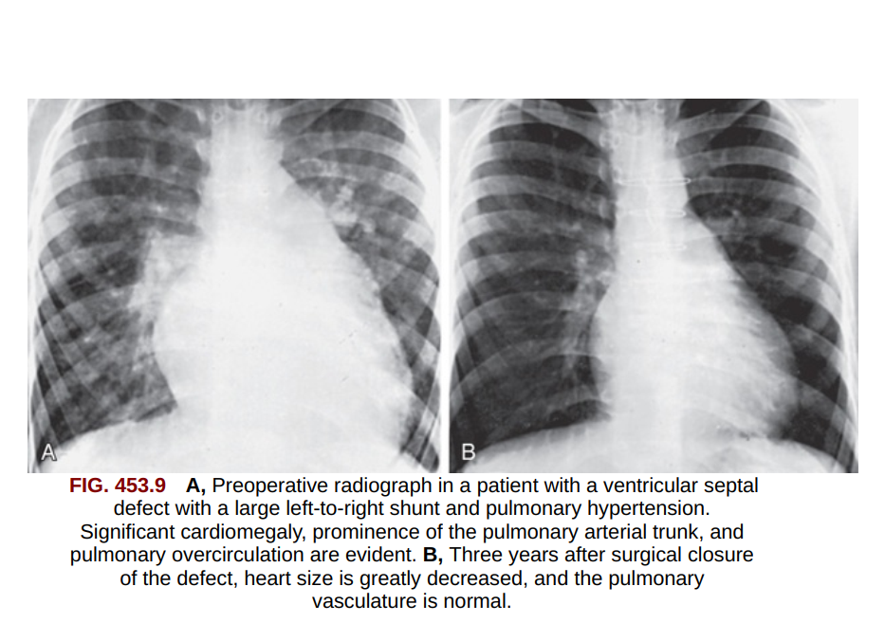

Slide 37
VSD…
Prognosis and complications:
8% of large VSD closed spontaneously.
Repeated LRTI, Endocarditis, cardiac failure & Eisenmenger physiology are common complications.
Small VSD in adults show increased episodes of arrhythmia, sub aortic stenosis and exercise intolerance.

Slide 38
1.1. VSD…
TREATMENT: Small VSD follow up and management:-
The child encouraged to live normal life with out restriction.
Prevention for endocarditis.
Echocardiography to screen for spontaneous closure and for the development of left ventricular out flow tract pathology (AS, AR).
Medical treatment has two aims
  To control heart failure.
  To prevent the development of pulmonary vascular disease.

Slide 39
1.1. VSD…
Surgery : Indications for surgery are:-
large defects with clinical symptom and FTT can’t be controlled by medical treatment.
Infants between 6-12 month of age with large defect and associated with pulmonary hypertension.
Patients older than 2 years with QP: QS ratio > 2:1.
Supracrystal VSD of any size to avoid risk of AR.
Severe pulmonary hypertension is a contraindication for surgery.
After surgery: All symptom abolish, pulmonary hypertension regress, cardiac medications no longer required, catch up growth in 1-2years

Slide 40
1.2. ASD:
An opening in atrial septum permitting the shunting of blood between the two atria.
Three major types;
  SINUS VENOSUS Type: high in the atrial septum. Least common form.
  OSTEUM SECUNDUM Type; the most common type. (10% of CHD)
  OSTEUM PRIMUM Type: low in position at AV junction.
  Associated with incompetence of anterior leaf let of MV so prevention for endocarditis is necessary.

Slide 41
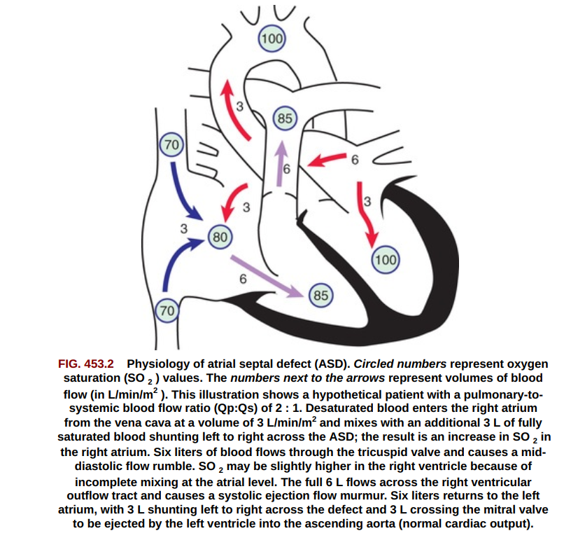

Slide 42
1.2. ASD
Pulmonary to systemic blood flow is between 2:1 to 4:1.
Patients may have dyspnea on exertion
Pulmonary vascular resistance remains low throughout child hood.
No murmur across ASD.
Diastolic rumbling murmur at the tricuspid valve with systolic ejection murmur & S2 split.

Slide 43
1.2. ASD:
CXR: Increase pulmonary artery vascularity.
ECG & ECHO: reveal pure right ventricular enlargement.
Prognosis and complication: secondum ASD is well tolerated up to the 3RD decade, endocarditis is rare & prophylaxis is not recommended.
Treatment: Surgery or Tran catheter device closure.

Slide 44
Case 2
A 3 months old infant presented at the OPD with a c/c of fast breathing and excessive sweating specially when she is feeding . She has no fever , she did not gain weight. She was treated as a case of pneumonia two times since the last four weeks .
On P/E has no cyanosis. She is tachycardic and in respiratory distress. Clear chest. CVS pericordial : Active precordium, shifted PMI, continuous murmur at the right upper sternal boarder . palpable liver 3 cm BRCM.

Slide 45
1.3. PATENT DUCTUS ARTERIOSUS(PDA).
is an abnormal persistence of a normal fetal pathway between the pulmonary artery and the aorta.
usually closes during the first 24-72hours
is seen in 10% of other CHD,
Females :males 2:1.

Slide 46
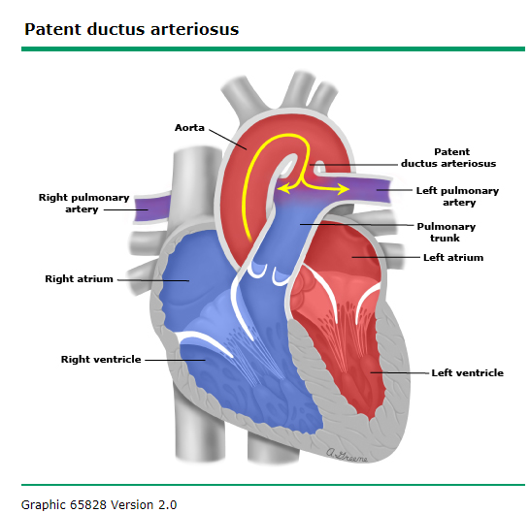

Slide 47
PDA...
Common in premature infants and following congenital infection (rubella virus).
In term infants the PDA walls deficient in both mucoid, endothelial and the muscular media.
But in premature infant the PDA wall has normal structure the patency is due to hypoxia and immaturity

Slide 48
CLINICAL MANIFESTATIONS
Determined by the degree of left-to-right shunting,
which is dependent upon the size and length of the PDA, and the difference between pulmonary and systemic vascular resistances.
The hemodynamic consequences of the PDAs can be categorized by the degree of left-to-right shunting based upon the Qp:Qs ratio.
Small − Qp:Qs <1.5 to 1
Moderate − Qp:Qs between 1.5 and 2.2 to 1
Large − Qp:Qs >2.2 to 1

Slide 49
PDA…
The major physiologic consequence of the shunt is left atrial and left ventricular volume over load.
Large ductus:
  Up to 70% of left ventricular out put shunted.
  Congestive heart failure is common.
  Has a Risk of developing pulmonary vascular resistance.
  A wide systemic pulse pressure that produce bounding pulse.

Slide 50
  Large PDA:
  The left ventricular impulse is hyper dynamic.
  Systolic thrill and continuous machinery murmur at the left upper sternal border..
  Low pitched rumbling mid diastolic mitral valve murmur at the apex.
  Prominent right ventricular impulse in the presence of pulmonary hypertension & differential cyanosis.

Slide 51
PDA…
ECG: Left or biventricular enlargement/deep Q and tall T-wave
CXR: cardiomegaly with left ventricular silhouette.
- Plethoric lung.
Echocardiography: identify the PDA.
Cardiac catheterization: To rule out aortico-pulmonary fistula

Slide 52
Assessment of severity:-
  The larger the heart size the larger the left to right shunt.
  Absence of 3RD sound and delayed diastolic murmur indicate small shunt.
  The wider the pulse pressure the larger the shunt.
Small ducts:-asymptomatic, normal pericordial activity, other findings are variable.
  ECG and CXR’s are normal.

Slide 53
TREATMENT ;
Medical therapy:
Congestive heart failure treatment
infective endocarditis prophylaxis
Closure of the PDA coil embolization or device closure without thoracotomy
Surgical closure of the PDA (ligation)

Slide 54
2. Obstructive Lesions
Hemodynamic Alterations
  increasing the resistance to ejection
  a higher systolic pressure to force a normal cardiac out put through the obstructive lesion.
  Pressure difference between the ventricle and the great artery and an increase in the muscle mass of the affected ventricles.

Slide 55
2.1. pulmonary stenosis with intact ventricular septum.
The most common type of obstructive lesions.(7-10% of all CHDs.)
No symptom with mild &moderately severe disease.
Right ventricular lift.
Grade 1/6-4/6 systolic ejection murmur at pulmonary area
S2 widely split with soft to inaudible P2.
Cyanosis and high incidence of right side heart failure in severe cases.

Slide 56
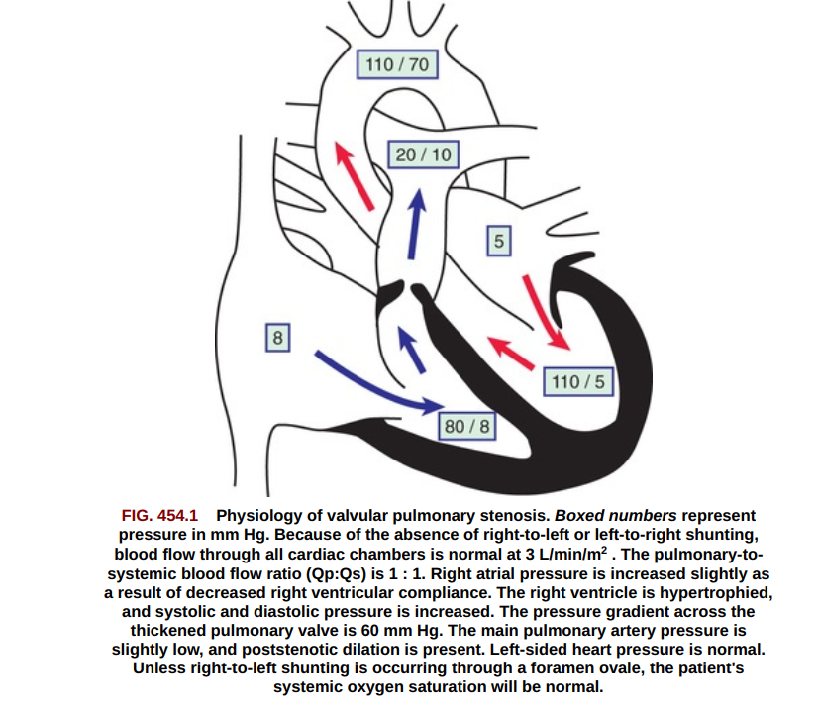

Slide 57
Pulmonary stenosis/PS
Depending on the severity classified as :-
  Mild PS: right atrial pressure 10- 30mmHg
  Moderate PS: right atrial pressure gradient between 30-60mmHg.
  Severe PS: mild to moderate cyanosis with sign of right side heart failure.

Slide 58
Pulmonary stenosis…
Prognosis and complications
  Heart failure occurs in very severe cases usually in the first month of life.
  Endocarditis is a risk but not common in childhood.
Treatment
  Moderate to severe pulmonary stenosis needs relief of obstruction.
  Balloon valvuloplasty
  Surgery; for severely thickened pulmonary valves.
*No difference in patient status after valvuloplasty or surgery.

Slide 59
2.2. Left ventricular out flow obstructions:
2.2.1.Congenital aortic stenosis
Account 5% of CHD
Can be one of the three types
  Valvular stenosis: most common type.
  Sub valvular stenosis: beneath the aortic valve.
  Supra valvular stenosis: above the aortic valve.
Sub valvular stenosis may progress rapidly in severity .usually occurs with other CHD

Slide 60
AS…
Physiologic importance
  Impose resistance to left ventricular empting.
  Increased left ventricular muscle mass
  Compliance decreases and diastolic pressure rises.
  CHF and disproportional increase in coronary circulation (blood supply & demand imbalance) -> myocardial ischemia.
  Generalized fibrosis may result from a long standing supply-demand imbalance.
  The sub endocardium is particularly vernerable to ischemia as a result papillary muscle infarction and mitral regurge may occur.

Slide 61
AS…
Mild to moderate obstruction does not lead to symptom.
Severe obstruction during infancy also known as critical aortic stenosis and is associated with left ventricular failure or profound low cardiac out put and shock.
Older children and adolescents with severe AS have symptoms of angina pectoris and may experience episodes of syncope.
Louder, harsh and longer murmur indicates greater degree of obstruction.

Slide 62
AS…
ECG: LVH &inverted T-wave on left pericardial lead.
CXR; Prominent Ascending Aorta, no cardiomegaly, valvular calcification on older children.
Echo: ventricular hypertrophy thickened and domed aortic valve. Other anomalies in 20% of patients with AS.
Cardiac catheterization: measure the magnitude of the pressure gradient from the left ventricle to the aorta.

Slide 63
AS…
Prognosis: Progression of disease seen in 5-10yr for mild to moderate ds.
Infants with critical aortic stenosis may have severe heart failure and deteriorate rapidly to shock state.
Based on aortic gradient can be mild ds (b/n 40-50mmHg), moderate disease (b/n 50-70mmHg) and severe ds >70mmHg )
Sudden death is a significant risk for severe AS.
AS is a Common Cause of Sudden Death in children so avoid competitive sports in children with moderate to severe disease .

Slide 64
AS…
TREATMENT:
Balloon valvuloplasty: for mod. to severe disease.
Indication:-
When systolic gradient between aorta and left ventricle exceeds 60-70mmHg.at rest.
For symptomatic patient and ECG changes lesser gradient<60mmHg.
For rapidly progressive disease gradient of 40-50mmHg is operable.
Surgery; for neonatal age due to inaccessible arteries and sub AS.
Life time prophylaxis for Endocarditis.

Slide 65
Case 3
Chala is 8 yrs old seen at the clinic for URTI and when the nurse took the vital sign she noticed a high blood pressure and notified the physician .
The physician examined him and he found the BP discrepancy between upper and lower extremities and checked the pulse and identified a strong pulses in the upper extremities but very weak pulse at the lower extremities . No other abnormal physical finding.

Slide 66
2.2.2.COARCTATION OF THE AORTA.
A localized narrowing of the aorta either proximal (preductal) or distal (post ductal) to the ductus.
Simple coarctation of aorta almost always (in 98% of the cases) is juxta ductal.
account 6% of all CHD, common in males M: F 3:1.
In preductal coarctation, the ductus remains open and shunts blood from the pulmonary artery through the ductus arteriosus into the aorta.

Slide 67
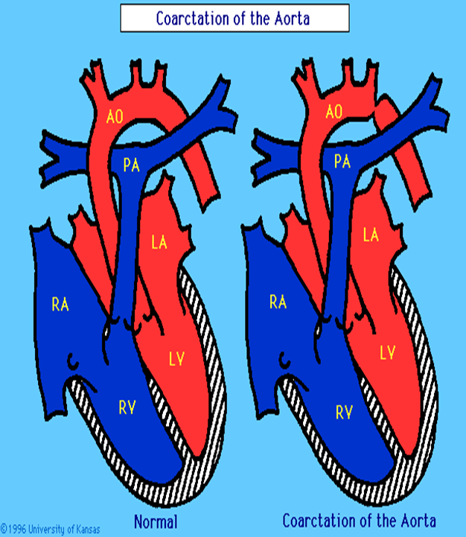

Slide 68
COARCTATION…
In 70% of patients bicuspid aortic valve.
Mitral valve abnormality, subaortic stenosis are a potential associated lesions.
- When coarctation occurs with these lesions called Shone complex
In post ductal coarctation and in mild juxta ductal type (adult type) symptoms do not arise till late adolescent or adult life.

Slide 69
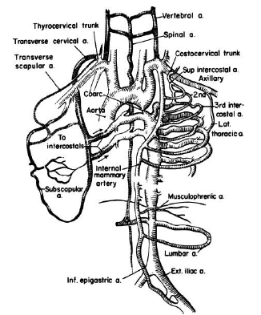
Pathophysiology
In case of severe COA when the ductus closed flow to the head and neck vessels is maintained.
Flow to the lower body distal to the coarctation site is dramatically reduced and may lead to shock.
As the result:
Elevation of systolic pressure in proximal aortic segment. (Upper extremities )
  Vasoconstriction of arterioles to maintain diastolic pressure
  Collateral formation to by pass the obstruction .

Slide 70
Clinical Manifestations
Severe critical stenosis the neonate present with evidence of CHF if not corrected surgically result in death.
Past the neonatal period Usually asymptomatic
Older children:
        Headaches
        Epistaxis
        Claudication, cold feet

Slide 71
Physical Examination:
Weak or absent femoral pulses
Increased B/P in the upper extremities
B/P difference between upper and lower extremities
Radio Femoral pulse delay ( Collaterals)
A2 is loud , systolic murmur 3rd and 4th ULSB ( if associated bicuspid aortic valve)
Notes:
DIFFERENTIAL CYANOSIS: A difference of >3 percent in the oxygen saturation measured in the right hand (preductal) and either foot (postductal) identifies infants with differential cyanosis. Differential cyanosis also occurs in infants with structurally normal hearts who have persistent pulmonary hypertension of the newborn.

Slide 72
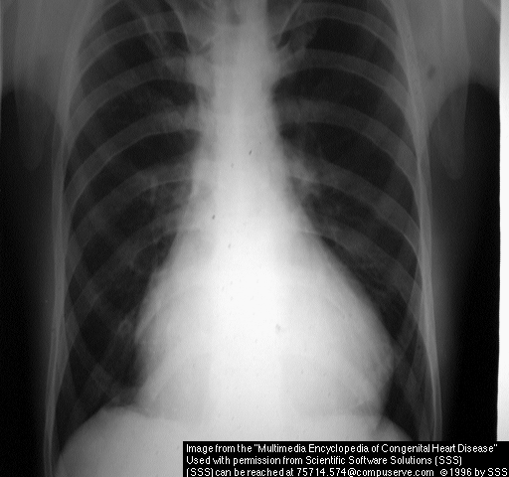
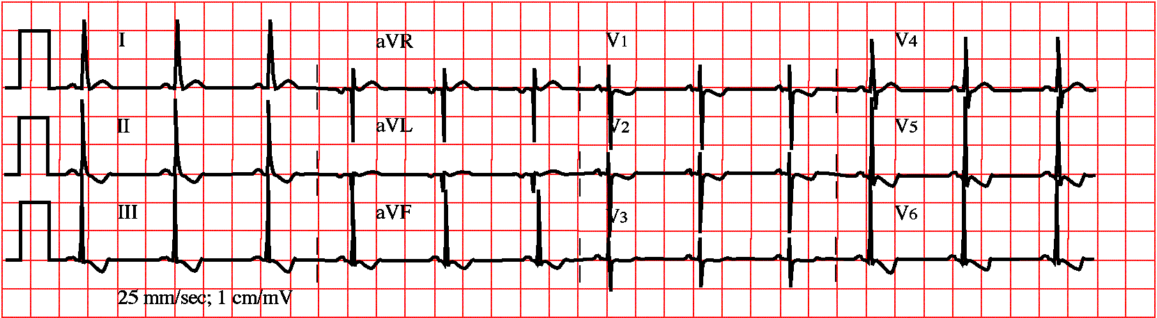
Cont….
Chest x-ray:
Dilated descending Aorta, enlarged LV.
Rib notching
ECG: normal in childhood, later LV hypertrophy.

Slide 73
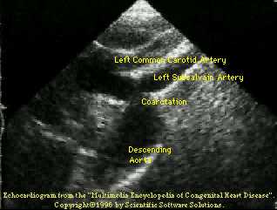
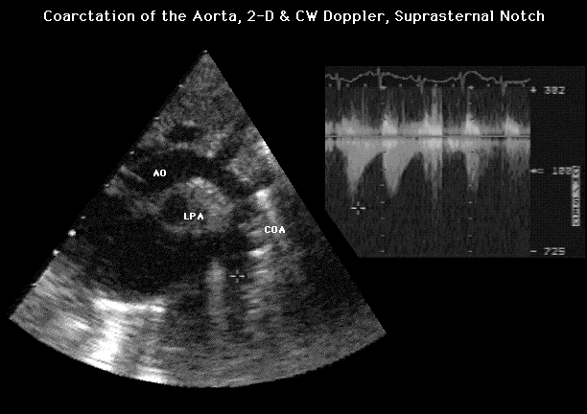
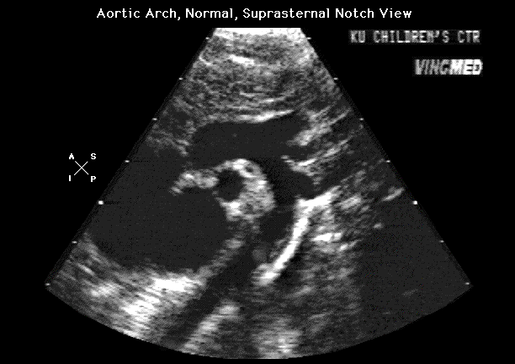
ECHO
Measure the stenotic area
gradient

Slide 74
TREATMENT:
Medical treatment of hypertension before surgery otherwise risk of post operative malignant hypertension.
In neonates with severe coarctation closure of the ductus often result hypo perfusion, acidosis and rapid deterioration.
-PGE1 should be given .
Surgery remain the treatment of choice
Balloon angioplasty.

Slide 75
3. CYANOTIC CONGENITAL HEART DISEAE
Right to left shunt causes desaturation of systemic venous blood to enter the systemic arterial circulation.
Three groups of cyanotic heart lesions.
  Admixture lesions complete mixing of the systemic and pulmonary venous circuit in atrium, ventricle or great artery (e.g. Truncus. A)
  Pulmonary hypo perfusion:-reduced pulmonary blood flow and right to left shunt. ( e.g. TOF)
  Transposition of great arteries: the pulmonary and systemic circulations are separate and parallel.

Slide 76
3.1. Tetralogy of Fallot(TOF)
The commonest cyanotic congenital heart disease.
Has 4 essential components:
  Ventricular septal defect(large non restrictive VSD)
  Pulmonary stenosis.
  Overriding of aorta over the ventricular septum.
  Right ventricular hypertrophy.

Slide 77
TOF…
In few infants the pulmonary stenosis may be less severe, associated initially with a left to right shunt→ pink TOF.
Cyanosis usually develops few months after birth.
Cyanotic spells/paroxysmal hyper cyanotic attacks, hypoxic blue or “Tet’ spells are problem during the first two years of life.
The child assumes squatting position on exercise
Notes:
The child assumes squatting position on exercise which increase systemic venous return and increase pulmonary blood flow and decrease cyanosis.

Slide 78
TOF
Exercise and crying increase venous return and decrease systemic resistance which increases the cyanosis.
Older children have clubbing.
Heart failure is very rare.
No clinical cardiomegaly, but signs of right ventricular hypertrophy are present.
Systolic thrill and ejection systolic murmur at the pulmonary area.

Slide 79
ECG: RVH and peaked p-wave.
CXR: Oligemic lung, Boot shaped heart, heart not enlarged, concavity is found in the area usually occupied by the pulmonary artery. Ascending aorta is large and there is right aortic arch.
Complication:
  Cerebrovascular accident (CVA ), slugging and insitu thrombosis(Cerebral thrombosis) Common in less than 2years.

Slide 80
Complications of TOF…
  Brain abscess usually in children >2years of age less common than CVA.
  Anemia of iron deficiency makes the RBC somewhat stiffer and lead to less oxygen delivery.
  Bacterial Endocarditis.
  Paroxysmal Hypoxic spells
  Retardation of growth and Development
  Hemoptysis may result from thrombosis in the pull artery and/or due to platelet dysfunction

Slide 81
Treatment
Medical treatment for hyper cyanotic attacks
Placement of infants in knee chest position.
100% O2 administration.
Morphine 0.2 mg /kg SC.
Propranolol 0.1-0.2mg/kg IV may help severe spells then 0.5mg/kg/6hr orally.
Correct acidosis and anemia.
Consider operation.
Surgery: - complete repair is recommended before 6 months of age.

Slide 82
  3.2. TRANSPOSITION OF GREAT ARTERIES (TGA)
The commonest CHD Causing cyanosis shortly after birth and responsible for majority of deaths from cyanotic CHD in the 1st year of life.
The great arteries arise from the inappropriate ventricles, the aorta from the right and the pulmonary artery from the left.
Survival is depending on mixing of blood between the circulations through VSD, ASD, or PDA.

Slide 83
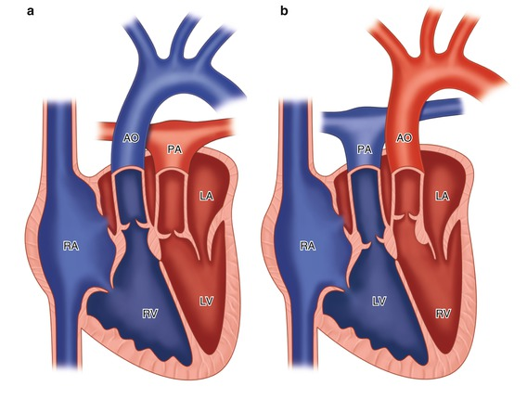

Slide 84
TGA…
Associated abnormality of the atrial and ventricular septum, AV valves and coronary arteries are common.
TGA with out VSD is the common variant. After birth mixing between the parallel circulations diminishes as the ductus arteriosus closes.
Severe hypoxemia, acidosis, and death can occur rapidly.
Cyanosis usually noted in the 1St day of life and progress rapidly as the ductus arteriosus closes.

Slide 85
TGA…
Differential cyanosis may be present.
- d-Transposition is the only condition that leads to preferential desaturation of the upper body.
S2 is loud because the transposed aorta lies anteriorly close to the chest wall.
No murmur usually or grade 2 systolic ejection murmur.
ECG: RVH and right axis deviation.
CXR: Cardiomegaly with a narrow base and plethoric lung fields. Gives egg on stick picture.

Slide 86
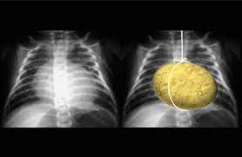

Slide 87
TREATMENT:
TGA is a true medical emergency as ductus closes severe hypoxia acidosis and death.
  PE1 administration immediately on diagnosis. Apnea is the feared complication.
  Surgery: arterial switch operation (ASO).
TGA with VSD predominantly present with sign of congestive heart failure. These patients usually develop pulmonary vascular disease within 3 months so the treatment is anticongestive followed by ASO with closure of VSD before 3 month of age.

Slide 88
  3.3. TRUNCUS ARTERIOSUS
A single great artery that arises from the base of the heart giving rise to the pulmonary, coronary and systemic arteries.
A large VSD is invariably present
Total pulmonary blood flow is excessive and effective thus cyanosis is mild..
High pulmonary blood flow cause pulmonary hypertension.
Volume over load over the left ventricle
  → severe heart failure.

Slide 89
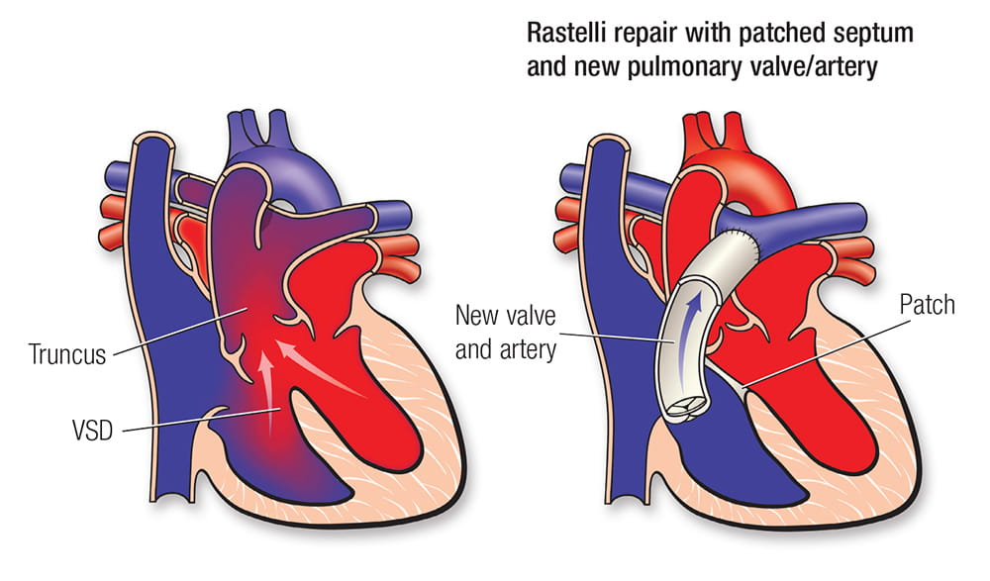

Slide 90
TRUNCUS ARTERIOSUS
Arterial pulse pressure is wide and arterial pulsations are bounding
Precordium is hyper active due to the pressure over loaded on RV and volume overloaded LV
Harsh and blowing type systolic murmur
Increased flow across the mitral valve → apical midiastolic murmur.

Slide 91
TRUNCUS ARTERIOSUS...
In older children with increased PVR, progressive cyanosis, polycythemia and clubbing may occur.
ECG: biventricular hypertrophy
CXR: cardiomegaly and increased pulmonary blood flow. Right aortic arch(in 40%), absent thymus→ deGorge syndrome
Echo →anatomy well seen with no demonstrable infundibulum.
Cardiac catheterization: pass in to pulmonary artery from the truncus. To see intracardiac defect and shunts.

Slide 92
TRUNKUS ARTERIOSUS...
Treatment and prognosis.
  Affected children should be evaluated for hypocalcaemia and T-cell deficiencies associated with DeGorge syndrome.
  Anticongestive treatment but not effective for prolongation of life.
  Surgery: Modified Rastelli procedure before the age of 2-3months.

Slide 93
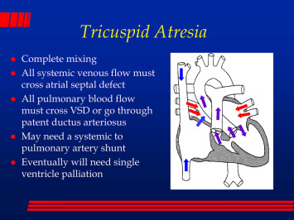
3.4. TRICUSPID ATRESIA

Slide 94
3.4. TRICUSPID ATRESIA
ECG: LVH tall p &R waves.
After 2-3years of age →inverted T Wave.
CXR: with small VSD and PS the lung fields are oligemic and heart size is normal.
Cardiomegaly and plethoric lung when pulmonary blood flow is un restricted
Echo: describes the anatomy.
Catheterization :only indicated before the surgery

Slide 95
Treatment and prognosis
  PE1 in new born with markedly decreased pulmonary blood flow to keep the ductus patent.
  Usually indicated in patients with small VSD and partial O2 saturation (so2) < 80 mmHg.
Surgery: Fontan procedure

Slide 96
  3.5. TOTAL ANOMALUS PULMONARY VENOUS CONNECTION. (TAPVC)
Failure of incorporation of the common pulmonary vein into the posterior wall of the LA.
Communications with the heart through anomalous connection to SVC which may drain to the coronary sinus or to right atria or directly to the right atria.
The clinical presentation depends on the type of anomalous drainage and the presence or absence of pulmonary venous obstruction.

Slide 97
TAPVC
Infants with obstructed pulmonary veins exhibit the condition in the new born period with severe cyanosis and tachypnea in the first few hours of life.
For children with mild or no obstruction cyanosis is subtle but may increase with crying or exercise. Heart failure may be very severe, with a Hyper active right ventricular impulse and a widely split 2nd heart sound.

Slide 98
TAPVC
ECG: marked RVH.
CXR: marked pulmonary venous congestion with normal heart at the new born which is similar to respiratory distress syndrome.
Cardiomegaly and increased pulmonary vascularity are seen on older children.
ECHO. sufficient for the decision of surgical procedure.
Cardiac catheterization is contraindicated
Contrast study further exacerbates pulmonary edema &RD

Slide 99
Treatment:
SURGERY, Opening a wide connection between the common pulmonary vein and the posterior wall of the left atria and ligation of the previous anomalous connections.
The prognosis is excellent with a risk of 2% and low incidence of postoperative complication.

Slide 100
  3.6. HYPOPLASTIC LEFT HEART SYNDROM (HLHS)
Includes a number of closely related anomalies that are part of hypoplasia and the under development of the LV.
Mitral and aortic valves usually are hypoplastic or atretic, and ascending aorta is usually small.
After birth the pulmonary venous return comes back to the left atria and must go across the atrial septum.
With small ASD Pulmonary venous pressure increase and sign of left side heart failure.

Slide 101
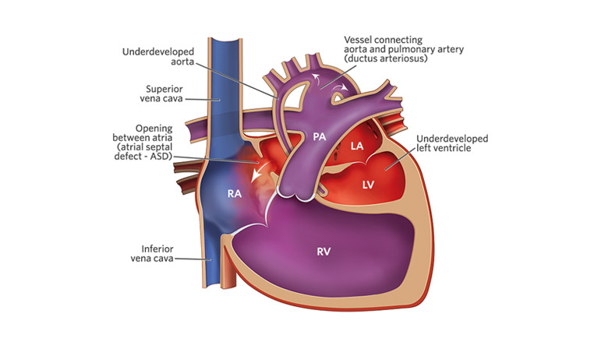

Slide 102
3.6.HLHS
Constriction of the ductus arteriosus lead to low COP and acidosis.
Usually asymptomatic before the ductus closes .Later the child exhibits profound cardio vascular collapse.
PE1 should be considered in any infant in shock, particularly if the child has hepatomegaly or poor response to fluid resuscitation.
ECG: RVH
CXR: cardiomegaly with increased pulmonary vascularity and congestion.
ECHO. Diagnostic. Right side of the heart is large.

Slide 103
3.6.HLHS
Treatment
Staged operation (3 stages). The overall survival rate is 50%.
Because of long term commitment and poor out come some families choose to refuse any surgery.
Cardiac transplantation is an alternative approach.

Slide 104
References
Nelson Text Book of Pediatrics 21 edition.
Nelson Essentials of Pediatrics.
UPTODATE 22

